Slide 1
(外研版)小学三年级英语上册 Module 7 Unit 1
What’s this?

Slide 2
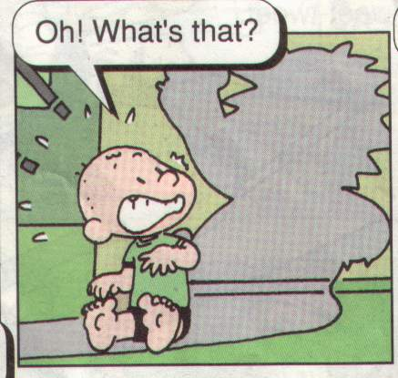

Slide 3
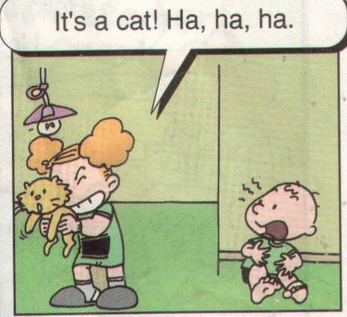

Slide 4
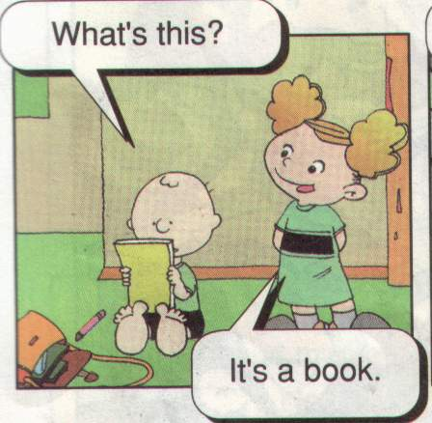

Slide 5
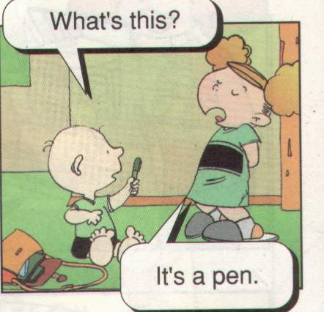

Slide 6
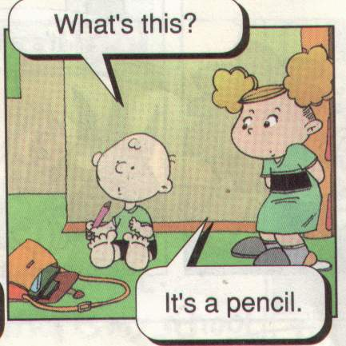

Slide 7
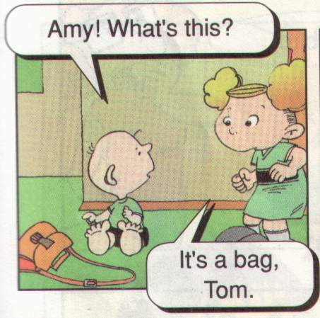

Slide 8
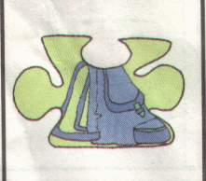
It’s a baɡ .
Notes:
PPT模板：www.1ppt.com/moban/ PPT素材：www.1ppt.com/sucai/
PPT背景：www.1ppt.com/beijing/ PPT图表：www.1ppt.com/tubiao/
PPT下载：www.1ppt.com/xiazai/ PPT教程： www.1ppt.com/powerpoint/
资料下载：www.1ppt.com/ziliao/ 范文下载：www.1ppt.com/fanwen/
试卷下载：www.1ppt.com/shiti/ 教案下载：www.1ppt.com/jiaoan/
PPT论坛：www.1ppt.cn PPT课件：www.1ppt.com/kejian/
语文课件：www.1ppt.com/kejian/yuwen/ 数学课件：www.1ppt.com/kejian/shuxue/
英语课件：www.1ppt.com/kejian/yingyu/ 美术课件：www.1ppt.com/kejian/meishu/
科学课件：www.1ppt.com/kejian/kexue/ 物理课件：www.1ppt.com/kejian/wuli/
化学课件：www.1ppt.com/kejian/huaxue/ 生物课件：www.1ppt.com/kejian/shengwu/
地理课件：www.1ppt.com/kejian/dili/ 历史课件：www.1ppt.com/kejian/lishi/

Slide 9
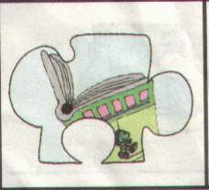
It’s a book.

Slide 10
It’s a desk.

Slide 11
It’s a desk.

Slide 12
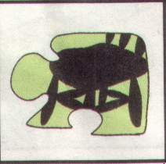
It’s a chair.

Slide 13
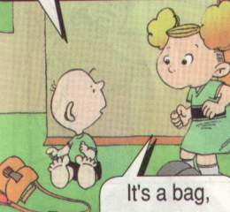
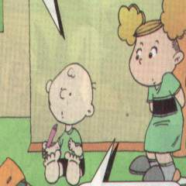
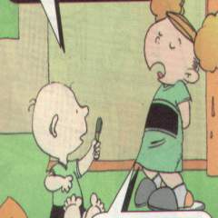
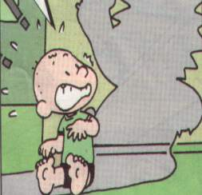
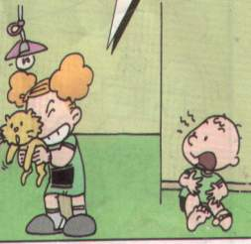

Slide 14
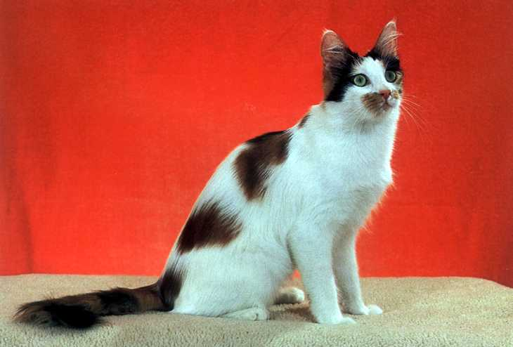
cat

Slide 15
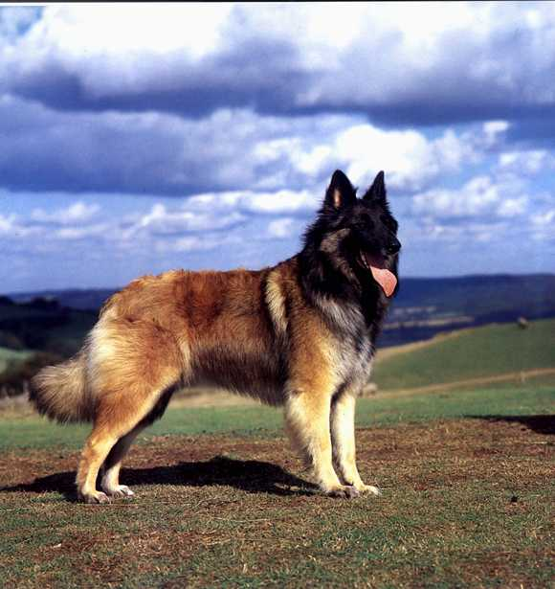
dog

Slide 17
door

Slide 18
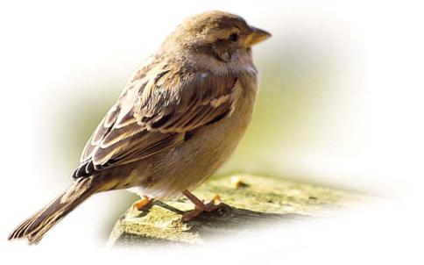

Slide 19
bird

Slide 20
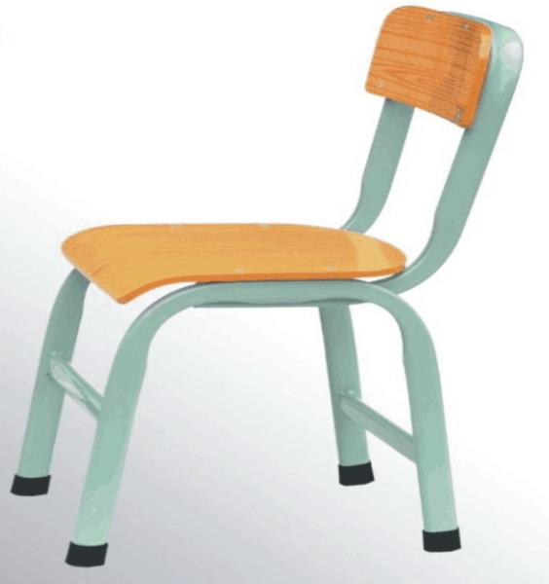

Slide 21
chair

Slide 22
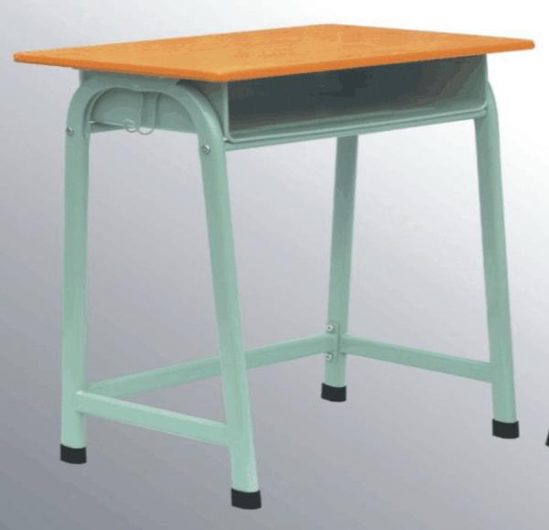

Slide 23
desk

Slide 25
window

Slide 26
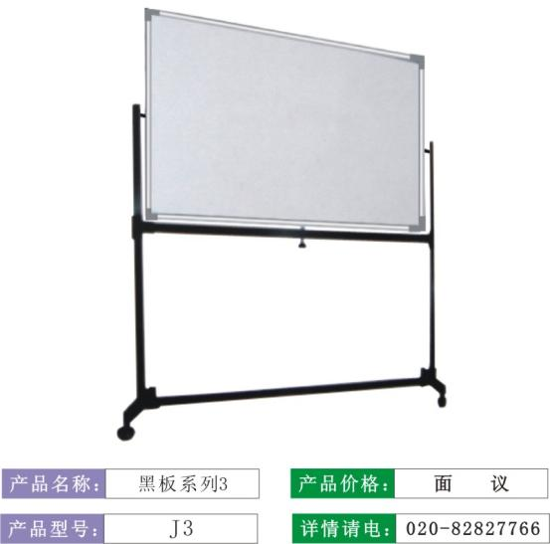

Slide 27
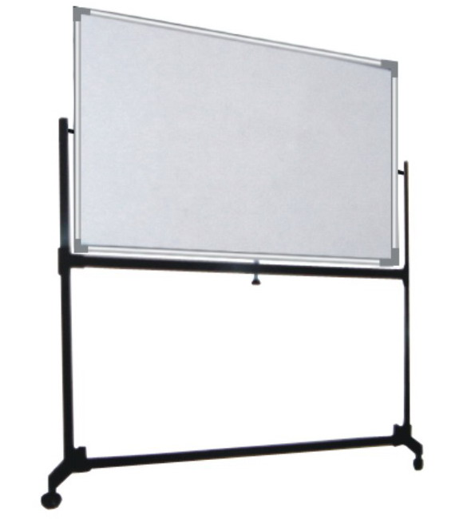
blackboard

Slide 28
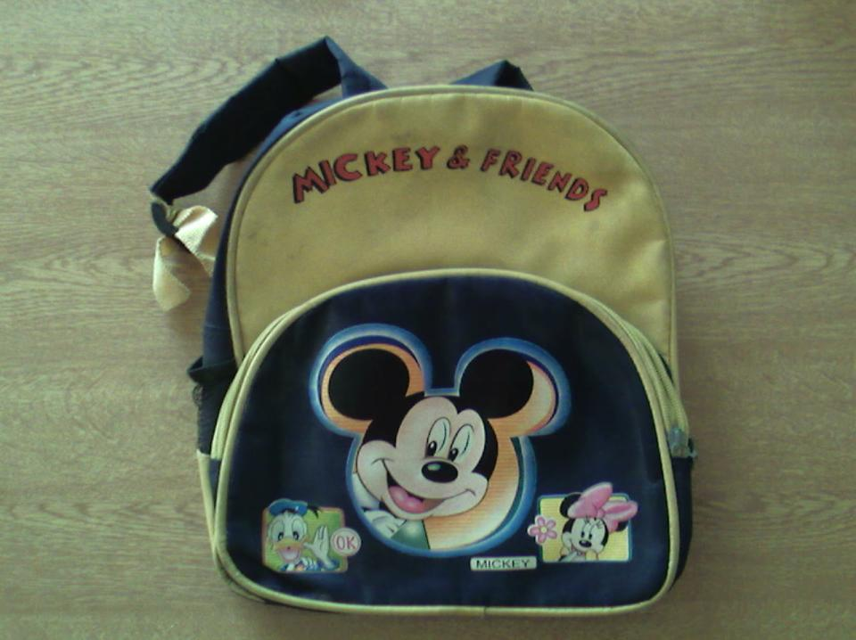
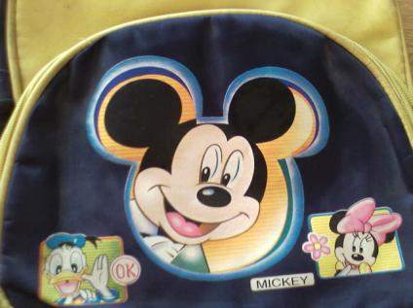
bag

Slide 29
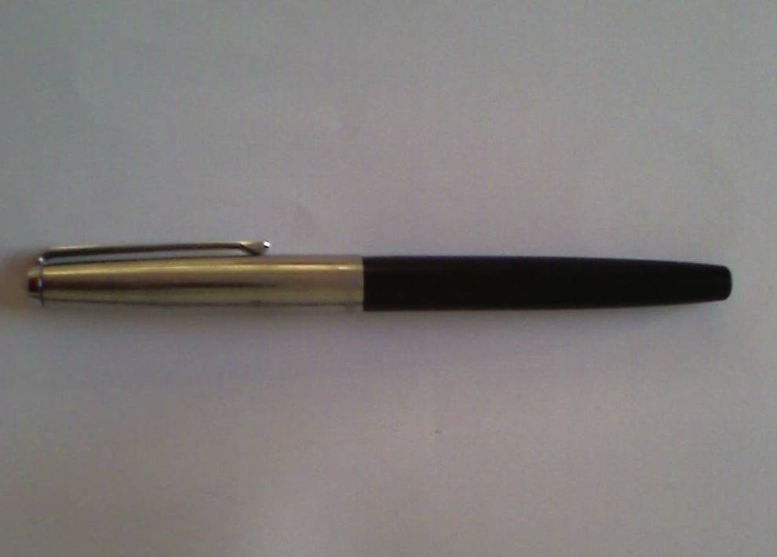
pen

Slide 30
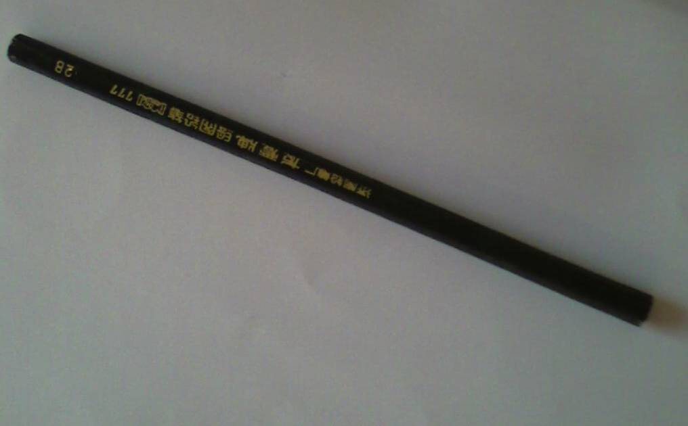
pencil

Slide 31
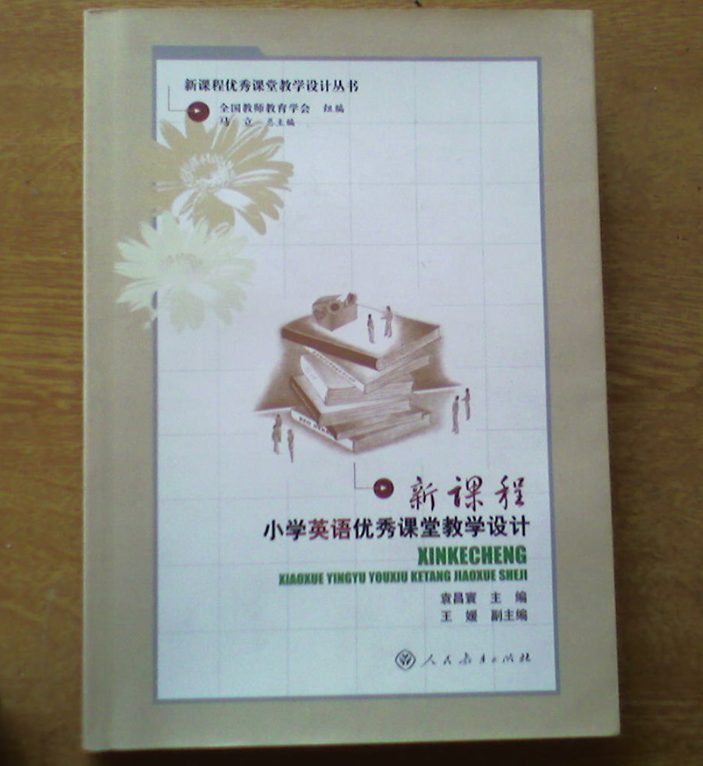
book

Slide 32
bag

Slide 33
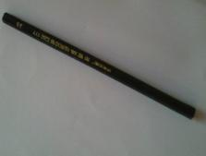
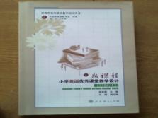
pen
pencil
book
bag

Slide 34
4.Listen and say, then chant.
Pen and pencil.
Pencil and pen.
Pen and pencil.
Say it again!

